Slide 1
Investigating transformations with Desmos
Transformations

Slide 2
how to use Oak lessons

Slide 3
I can investigate transformations using dynamic software.

Slide 4
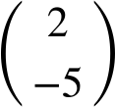
The object is the starting figure before a transformation has been applied.
The image is the resulting figure after a transformation has been applied.
A vector can be used to describe a translation. The vector shows the translation 2 units right and 5 units down.
A polygon is a flat (2D), closed figure made up of straight line segments.

Slide 5

Investigating transformations with Desmos
Investigating translation with Desmos
Investigating rotation with Desmos
Investigating reflection with Desmos
Investigating enlargement with Desmos

Slide 6
Investigating translation with Desmos
Dynamic geometry software can be used to quickly draw shapes and transform them.
It is called ‘dynamic’ because items can be moved and manipulated after they have been created.
This allows us to explore transformations and examine what happens when we change aspects of a diagram, after a transformation has already taken place.

Slide 7
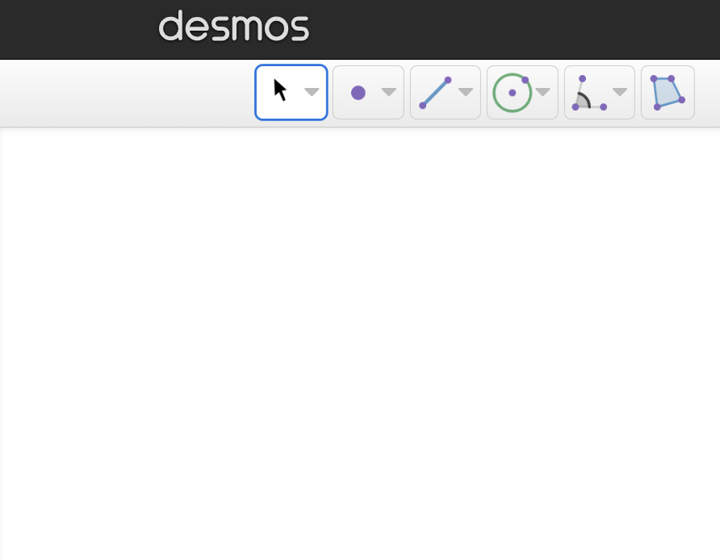
Investigating translation with Desmos
To get started:
Open up a web browser and go to desmos.com
Find and press the ‘Open Geometry’ button.
toolbar
workspace

Slide 8
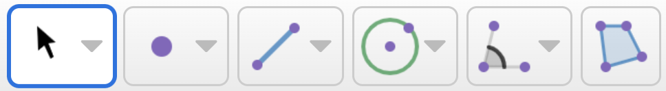
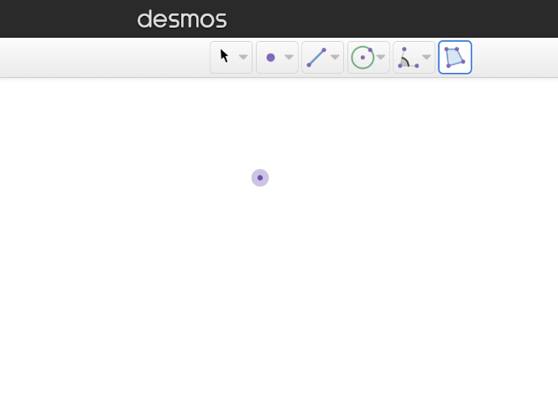
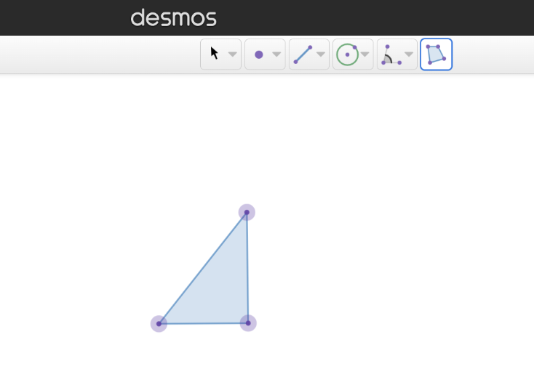
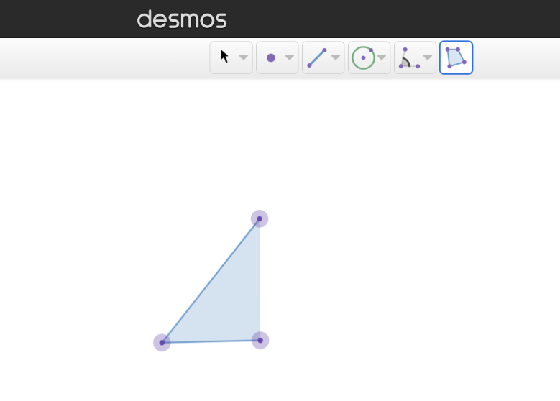
Investigating translation with Desmos
How to draw a polygon:
Click on the polygon tool.
Click on the workspace to insert some vertices.
Click on the first vertex again to complete the polygon.

Slide 9
Investigating translation with Desmos
A vector can be used to describe the movement in a translation.
For example, the vector represents a movement of 2 units
to the right and 5 units down.
Desmos represents vectors as a single arrow.
2
5

Slide 10
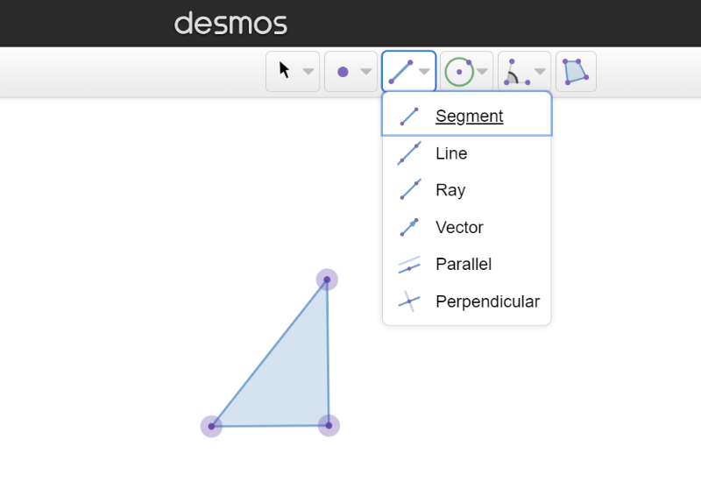
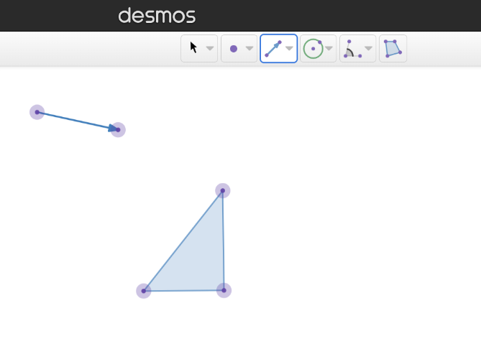
Investigating translation with Desmos
How to draw a vector:
Click the down-arrow on the line segment button to open up an option menu.
Choose ‘vector’.
Click two points on the workspace to insert a vector.

Slide 11
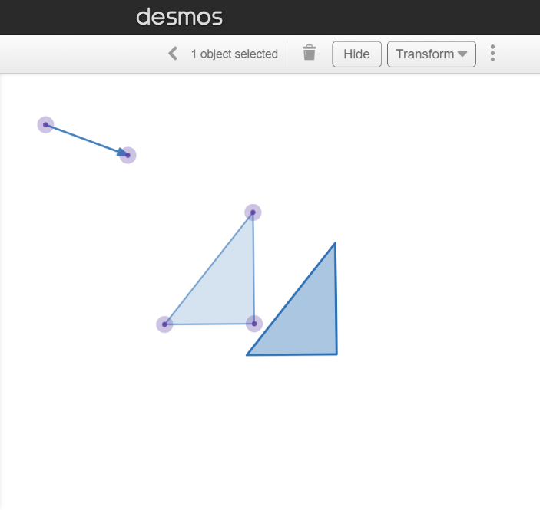
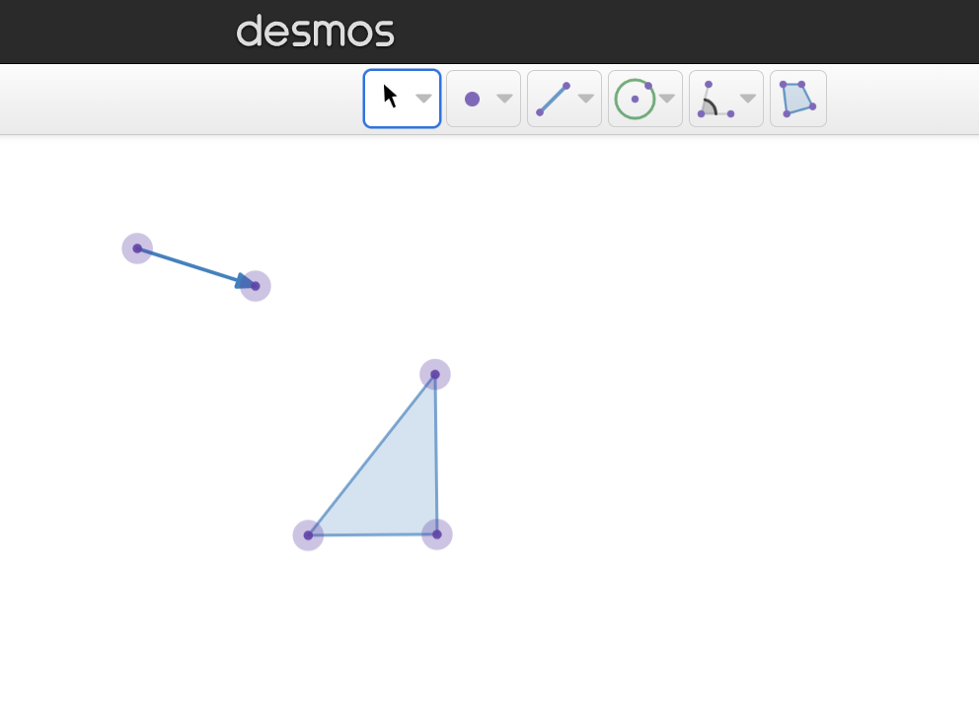
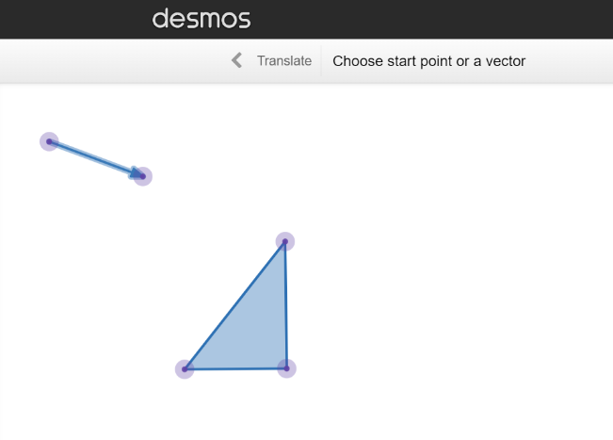
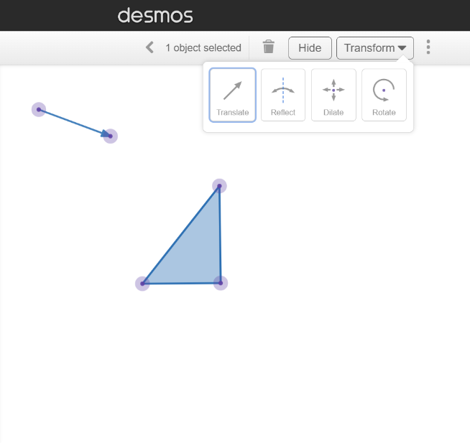
Investigating translation with Desmos
How to translate the object:
Click on the select tool.
Click on the polygon and click the ‘transform’ button to open up an option menu.
Choose ‘translate’.
Click on the vector.

Slide 12
Investigating translation with Desmos
We can describe the items in the workspace using mathematical terminology.
vector
The vector shows the movement between the object and image.
The new polygon that is created by the transformation is the image.
The polygon we select to transform is the object.
object
image

Slide 13

Investigating translation with Desmos
Which button allows you to draw a polygon?

Slide 14
Investigating translation with Desmos
Which button opens up the option menu containing the vector tool?

Slide 15
Investigating translation with Desmos
The ‘transform’ button is always displayed in the toolbar.
You need to click on the object before you can see the transform button.
You need to click on the transform button before you click on the object.

Slide 16
Investigating translation with Desmos
Draw any polygon and translate it to the right using a vector.
1) Click on your object and drag it around the workspace. What happens to the image? Why does it do this?
2) Click on the end of your vector and drag to make the vector longer. What happens to the image? Why does it do this?
3) Click on the middle of your vector and drag it around the workspace. What happens to the image? Why does it do this?

Slide 17
Investigating translation with Desmos
Draw any polygon and translate it to the right using a vector.
1) Click on your object and drag it around the workspace. What happens to the image? Why does it do this?
2) Click on the end of your vector and drag to make the vector longer. What happens to the image? Why does it do this?
The image moves with the object. This is because the vector is the same, so the image is always to the right of the object and the same distance away.
The image moves further away from the object. This is because a longer vector means the movement is a greater distance.

Slide 18
Investigating translation with Desmos
3) Click on the middle of your vector and drag it around the workspace. What happens to the image? Why does it do this?
The image does not move. This is because the vector still has the same size and direction.

Slide 19
Investigating transformations with Desmos
Investigating translation with Desmos
Investigating rotation with Desmos
Investigating reflection with Desmos
Investigating enlargement with Desmos

Slide 20
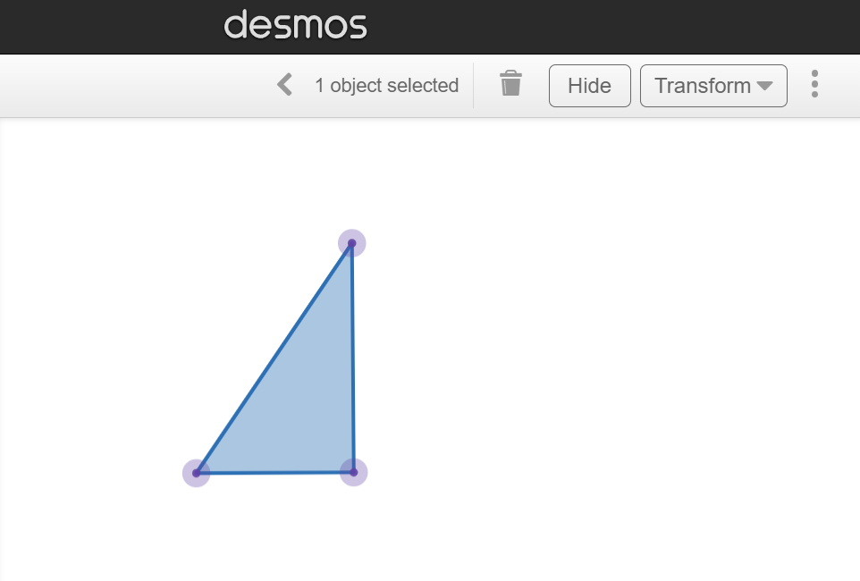
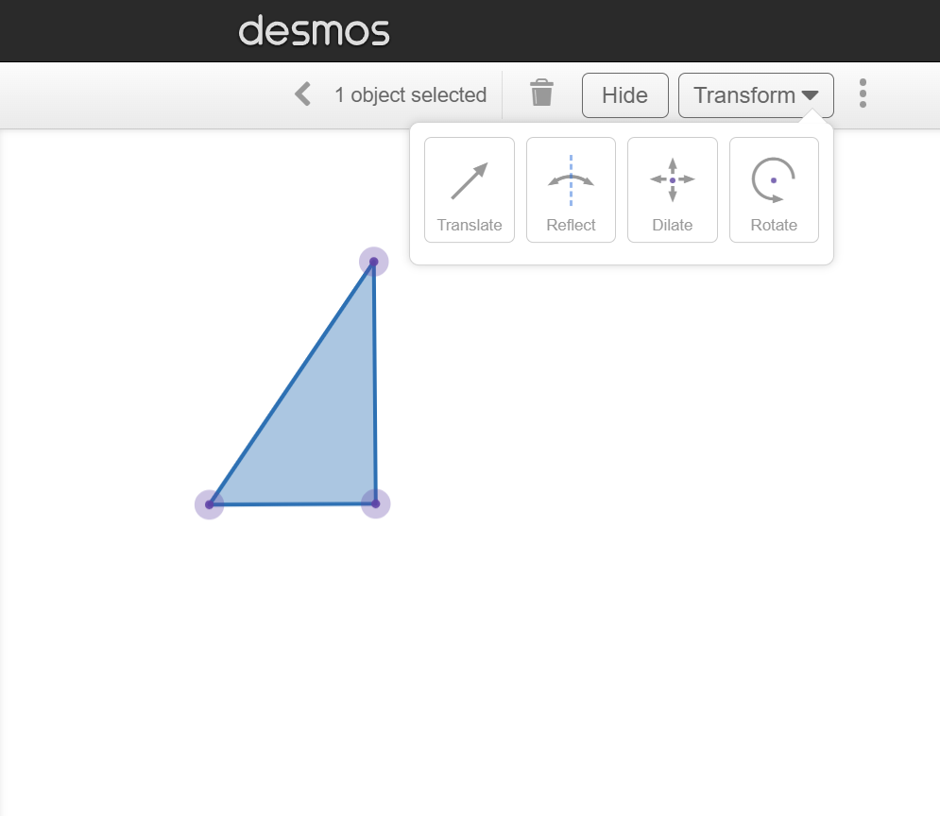
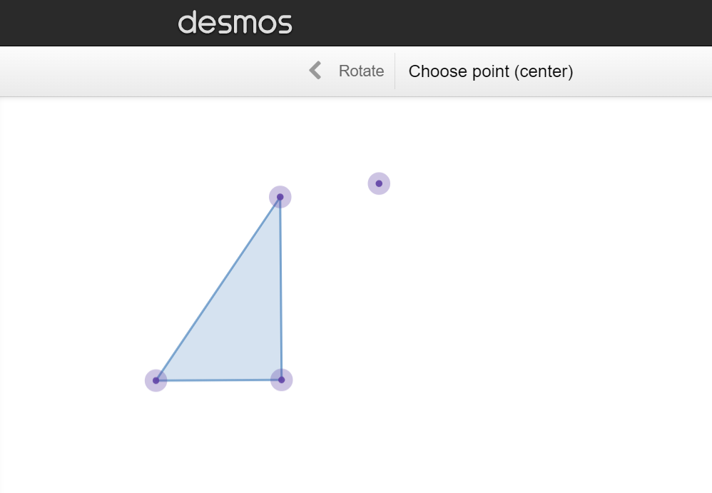
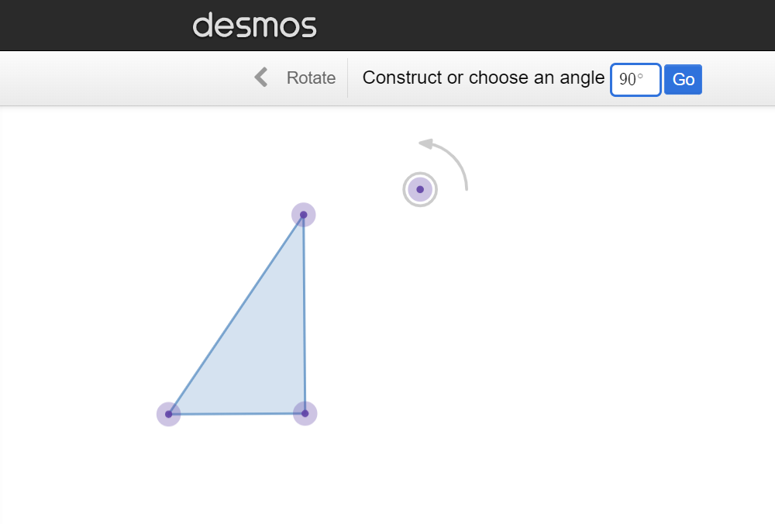
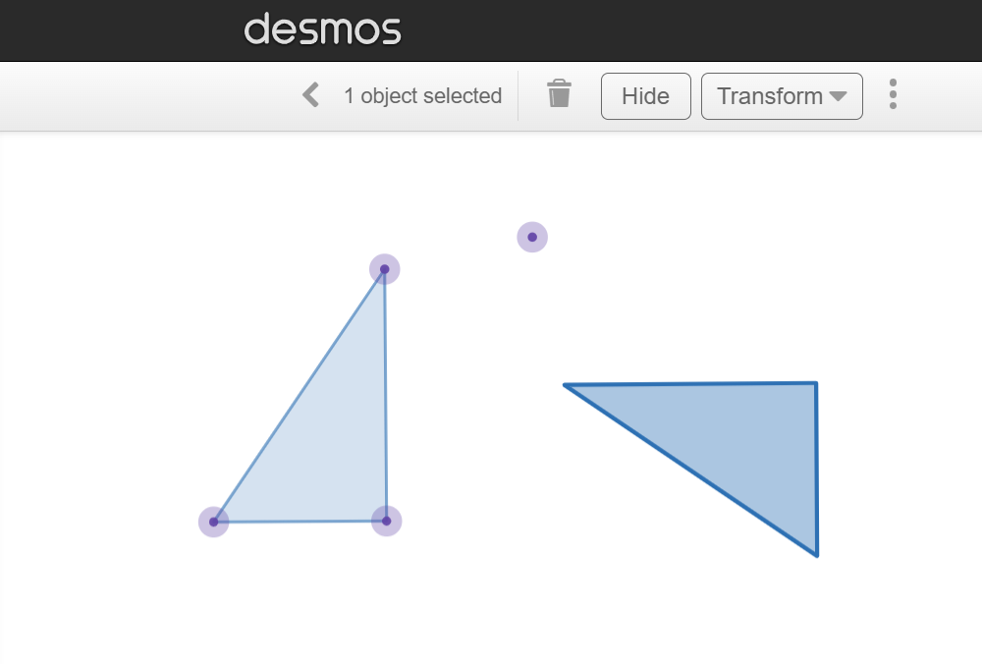
Investigating rotation with Desmos
How to rotate an object:
Using the select tool, click on the polygon and click transform.
Choose ‘rotate’.
Click a point on the workspace to plot a centre of rotation.
Type in an angle to rotate the object anticlockwise and press ‘go’.

Slide 21
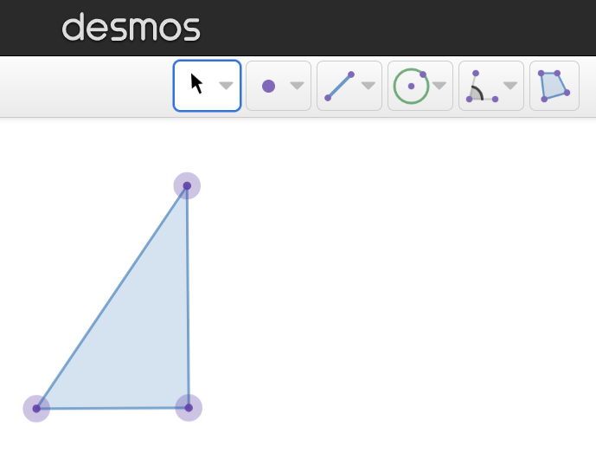
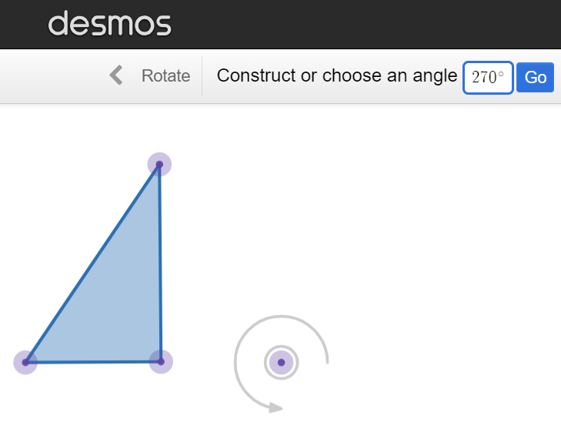

Investigating rotation with Desmos
Desmos only rotates shapes anticlockwise.
Clockwise rotations can be replicated by subtracting the angle from 360°.
Example:
Rotate the object 90° clockwise.
360 − 90 = 270°
90° clockwise is the same as 270° anticlockwise.

Slide 22
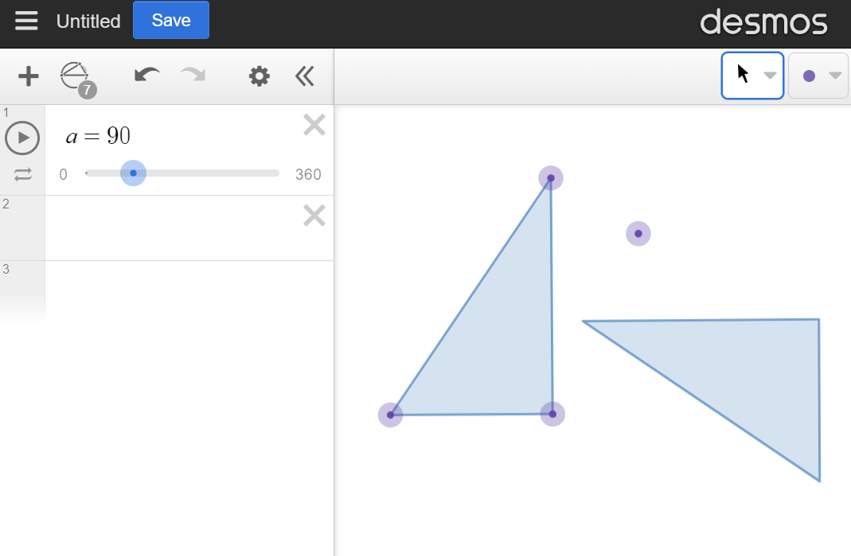
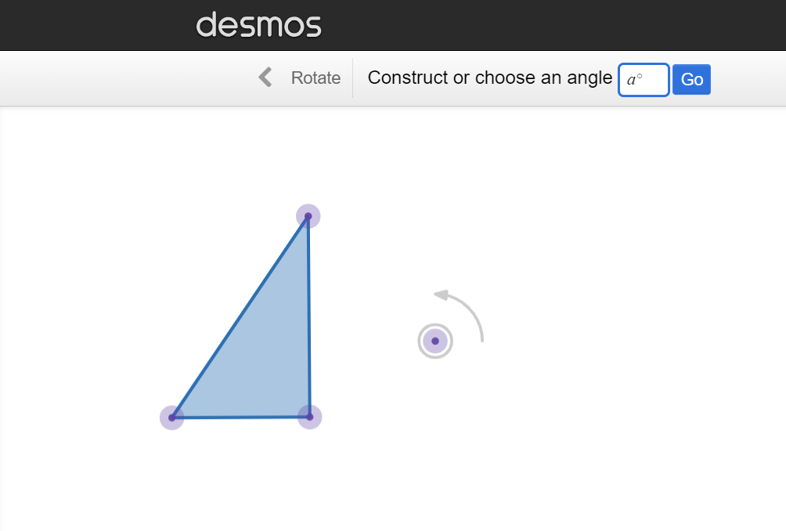
Investigating rotation with Desmos
We can make the angle of rotation dynamic by creating a slider.
Carry out the same steps to rotate an object.
Enter a letter for the angle.
A slider appears in the left panel.
Drag the slider left and right to change the angle of rotation.
slider

Slide 23

Investigating rotation with Desmos
The object will rotate 60° anticlockwise.
Desmos rotates objects clockwise.
Desmos rotates objects anticlockwise.

Slide 24
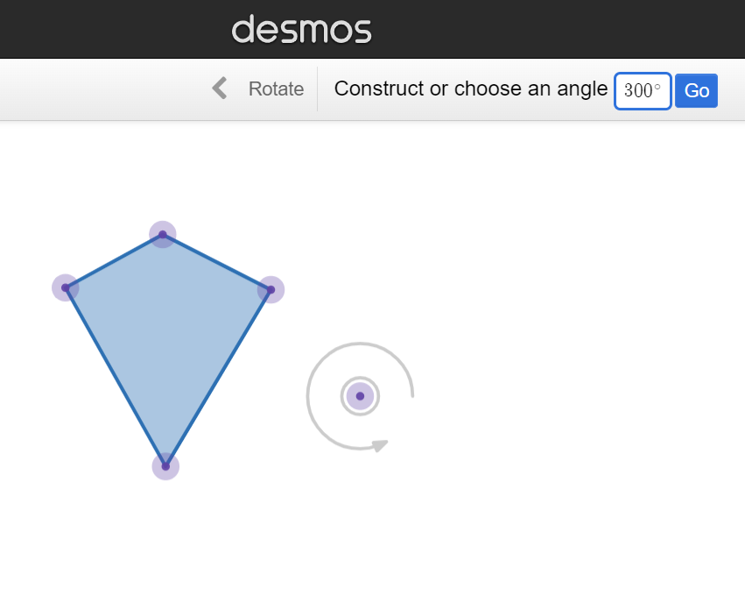
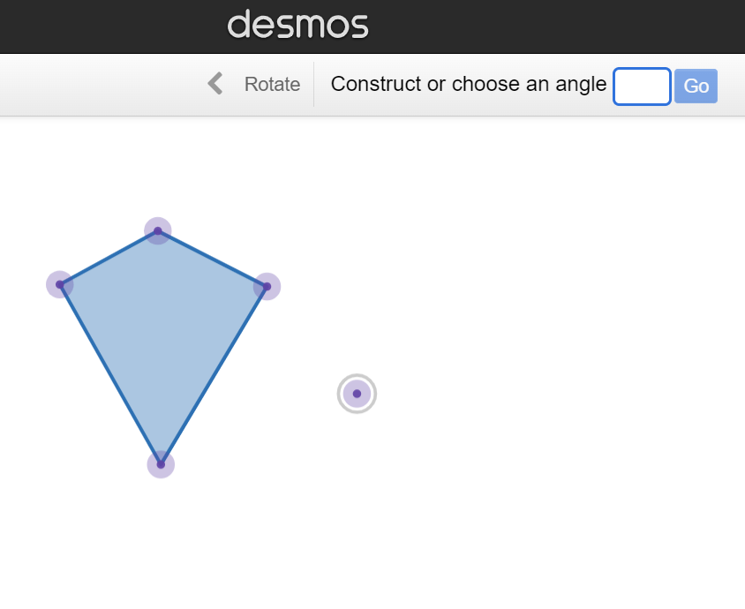

Investigating rotation with Desmos
Jun wants to rotate the object 60° clockwise.
Desmos only rotates anticlockwise.
What angle should he use?
360 − 60 = 300°
Jun

Slide 25
Investigating rotation with Desmos
Draw any polygon, rotate it using a slider and set the slider to 270°.
1) Drag the centre of rotation towards the image. What happens to the image? Why does it do this?
2) Is it possible for the centre of rotation to be inside the image? If so, how? If not, why not?
3) Move the spot in the slider left and right. For what angles does the image
perfectly overlay the object? Why does it do this for these angles?

Slide 26
Investigating rotation with Desmos
Draw any polygon, rotate it using a slider and set the slider to 270°.
1) Drag the centre of rotation towards the image. What happens to the image? Why does it do this?
2) Is it possible for the centre of rotation to be inside the image? If so, how? If not, why not?
The image moves aways. This is because the centre of rotation has moved further away from the object, so the distance to the image increases too.
Yes. When the centre of rotation is inside the object, it is also inside the image.

Slide 27
Investigating rotation with Desmos
3) Move the spot in the slider left and right. For what angles does the image
perfectly overlay the object? Why does it do this for these angles?
0° because the image has not turned. 360° because its a full turn.
If the slider went further, then it would also overlay perfectly for any multiple of 360°.

Slide 28
Investigating transformations with Desmos
Investigating translation with Desmos
Investigating rotation with Desmos
Investigating reflection with Desmos
Investigating enlargement with Desmos

Slide 29
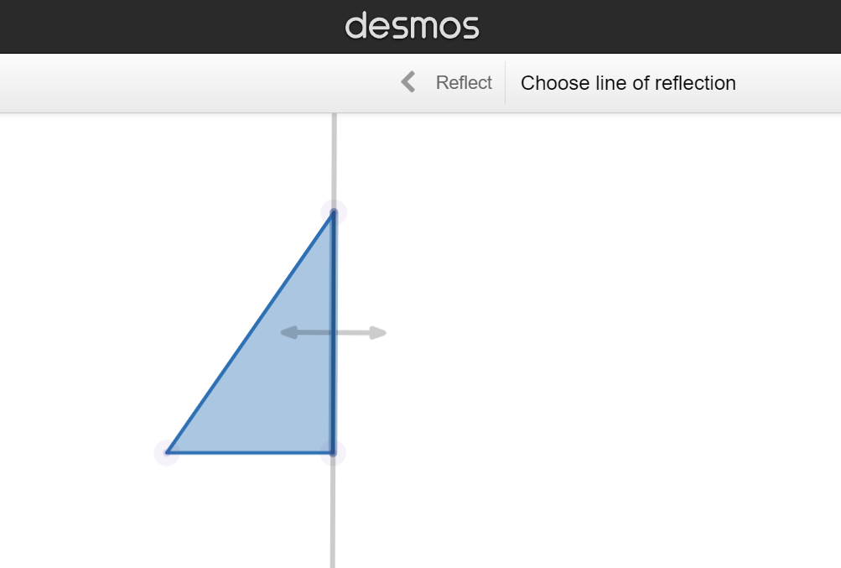
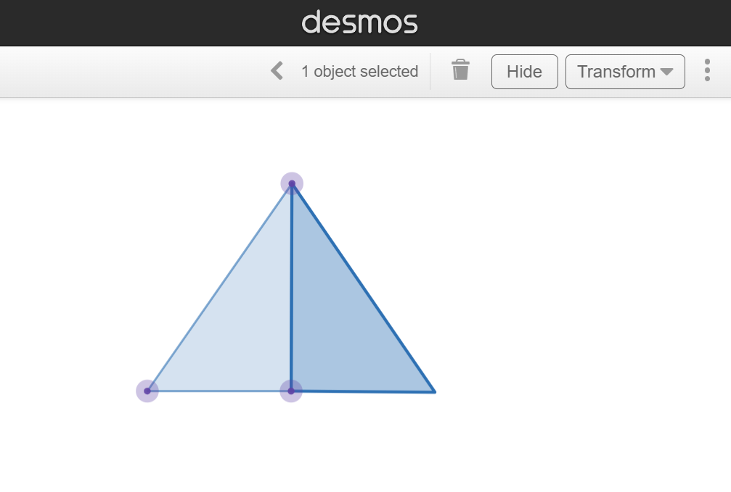
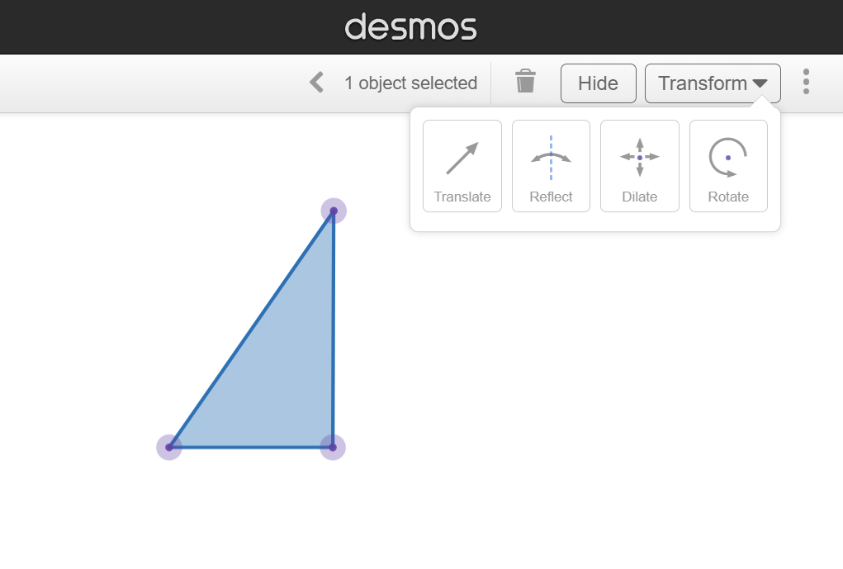
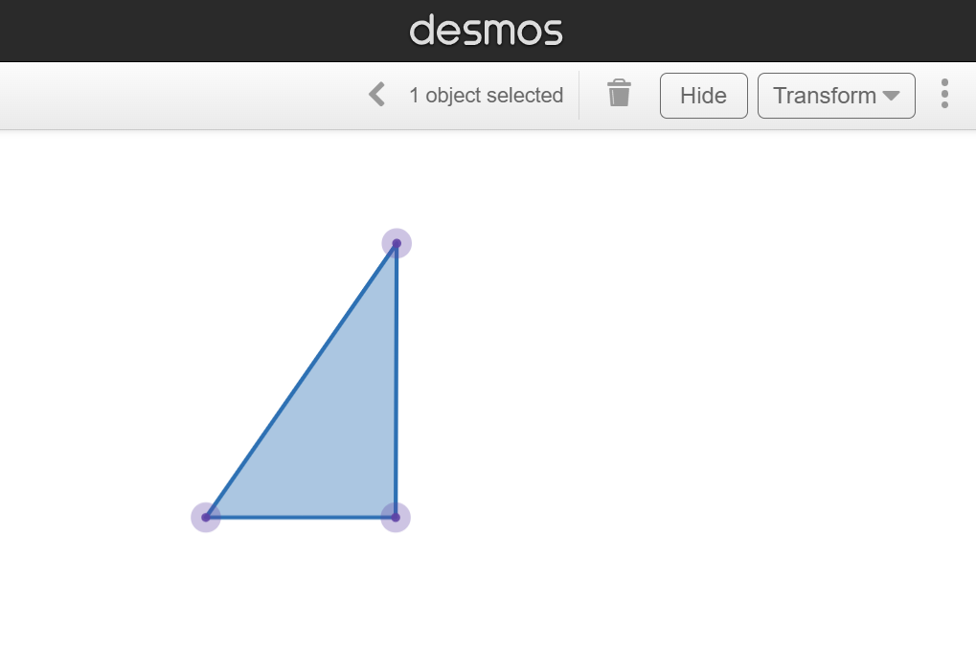
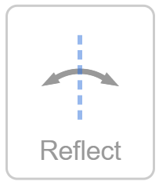
Investigating reflection with Desmos
How to reflect an object over an edge:
Using the select tool, click on the polygon and click transform.
Choose ‘reflect’.
Click one on of the edges of the object to reflect the image over that edge.

Slide 30
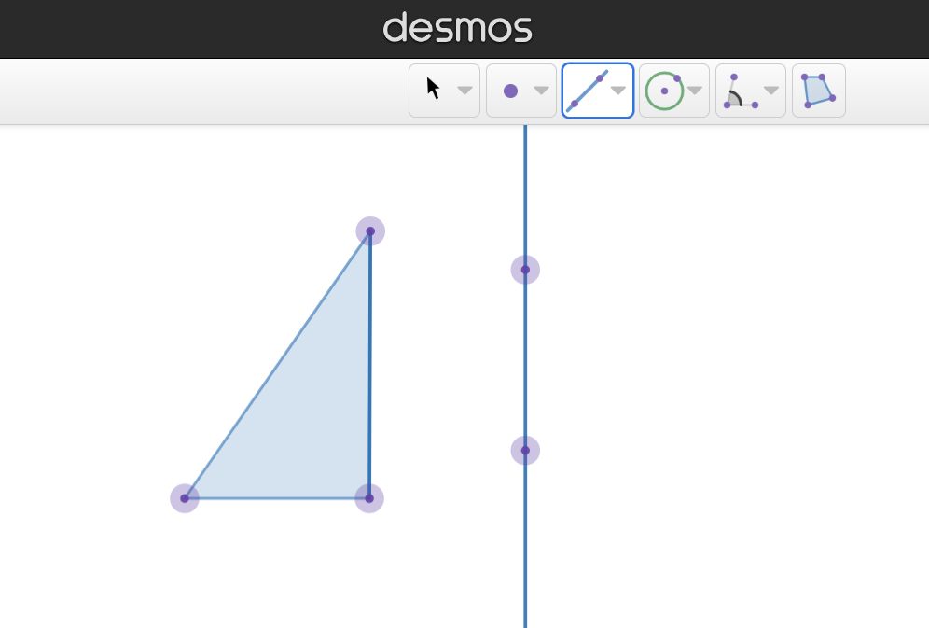
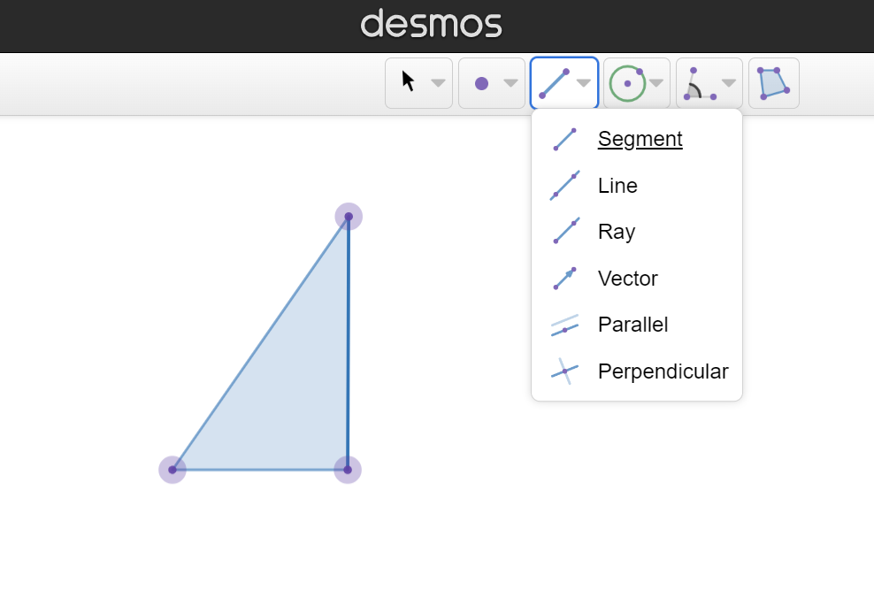
Investigating reflection with Desmos
How to draw a line:
Click the down-arrow on the line segment button to open up an option menu.
Choose ‘line’.
Click two points on the workspace to draw a line.

Slide 31
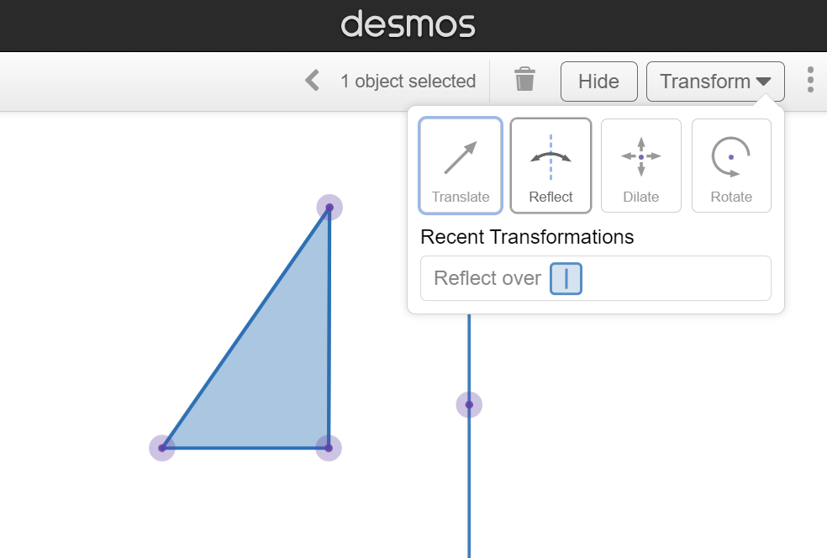
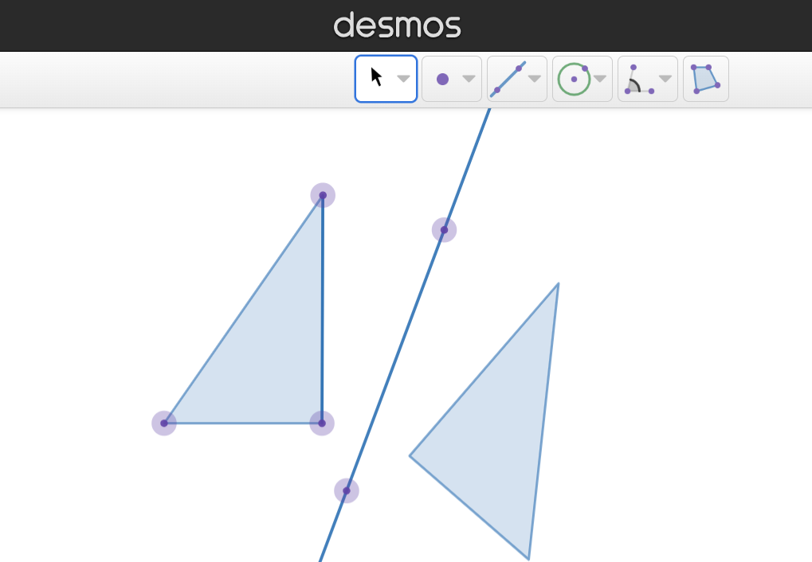
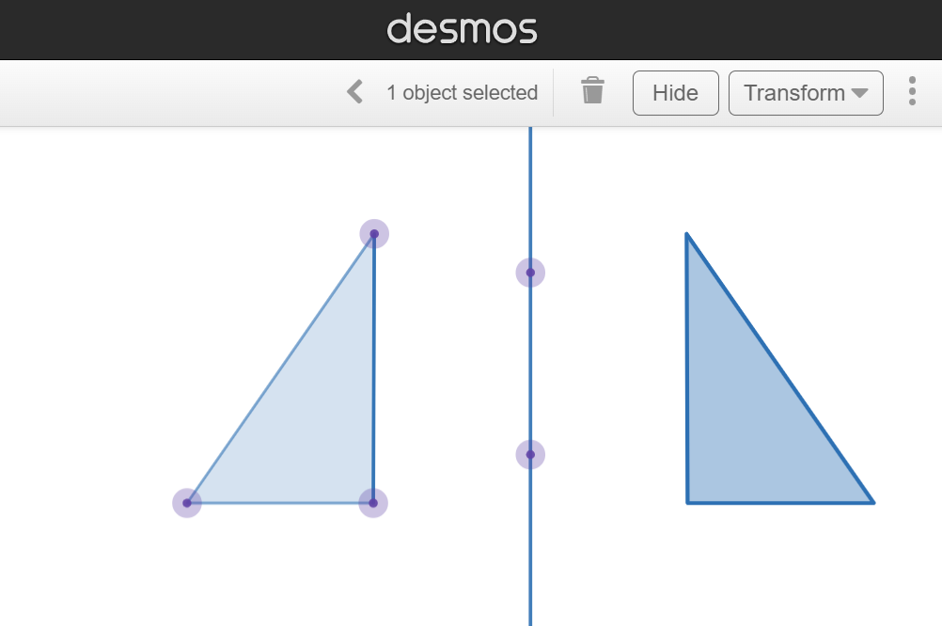
Investigating reflection with Desmos
How to reflect over a line:
Draw a line.
Click the object and select reflect, as before.
Click on the line.
Adjust the line by moving the points.

Slide 32
Investigating reflection with Desmos
Which button opens up the option menu containing the line tool?

Slide 33
Investigating reflection with Desmos
You always need to draw a line before you reflect an object.
The line tells Desmos where to reflect the image over.
You can reflect over one of the edges of the object.

Slide 34
Investigating reflection with Desmos
Draw a polygon where every edge is a different length (e.g. a scalene triangle). Draw a vertical line and reflect the polygon over the line.
1) Drag the line of symmetry towards the image. What happens to the image? Why does it do this?
2) Is it possible for the line of symmetry to be inside the image? If so, how? If not, why not? 3) Is it possible for the image to perfectly overlay the object? If so, how? If not, why not?

Slide 35
Investigating reflection with Desmos
Draw a polygon where every edge is a different length (e.g. a scalene triangle). Draw a vertical line and reflect the polygon over the line.
1) Drag the line of symmetry towards the image. What happens to the image? Why does it do this?
2) Is it possible for the line of symmetry to be inside the image? If so, how? If not, why not?
The image moves aways. This is because the line of symmetry is always equidistant between the object and image.
Yes. When the line of symmetry is inside the object.

Slide 36
Investigating reflection with Desmos
3) Is it possible for the image to perfectly overlay the object? If so, how? If not, why not?
No. This is because the image does not retain the sense of the object.

Slide 37
Investigating transformations with Desmos
Investigating translation with Desmos
Investigating rotation with Desmos
Investigating reflection with Desmos
Investigating enlargement with Desmos

Slide 38
Investigating enlargement with Desmos
In the UK, the word enlargement is used for a transformation that causes a change in size.
In the USA, the word dilation is used for a transformation that causes a change in size.
Desmos was created in the USA so uses the word dilate.

Slide 39
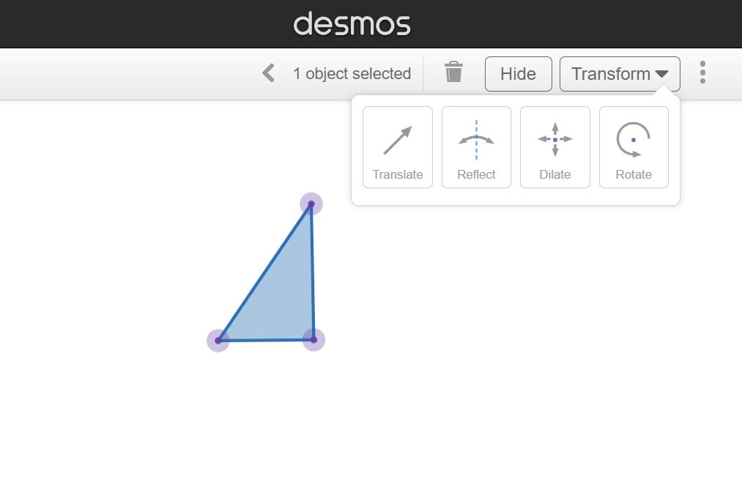
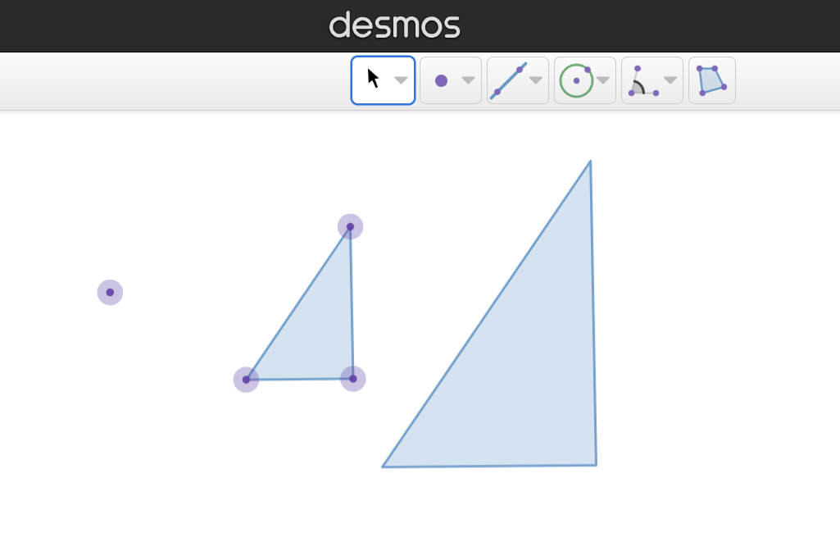
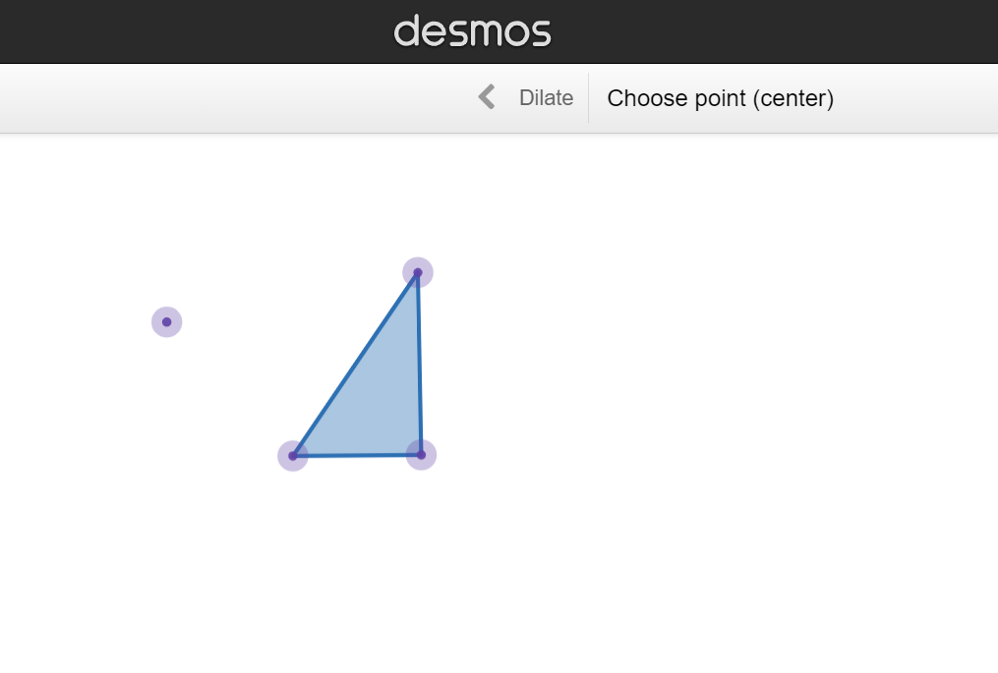
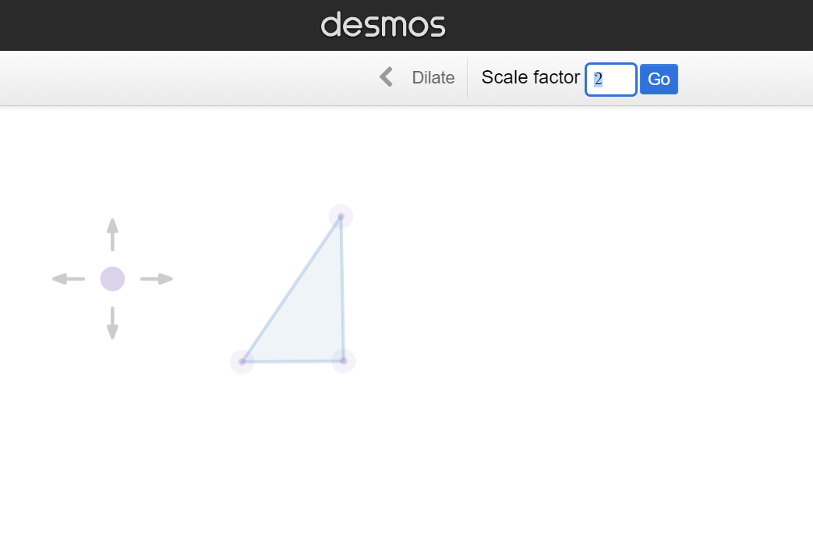
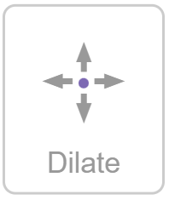
Investigating enlargement with Desmos
How to enlarge an object:
Using the select tool, click on the polygon and click transform.
Choose ‘dilate’.
Click a point on the workspace to plot a centre of enlargement.
Type in a scale factor to enlarge the object and press ‘go’.

Slide 40
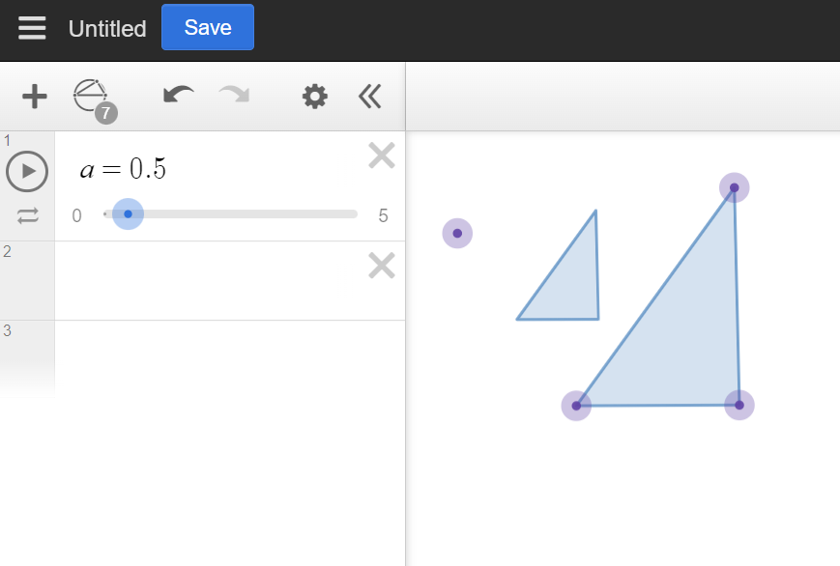
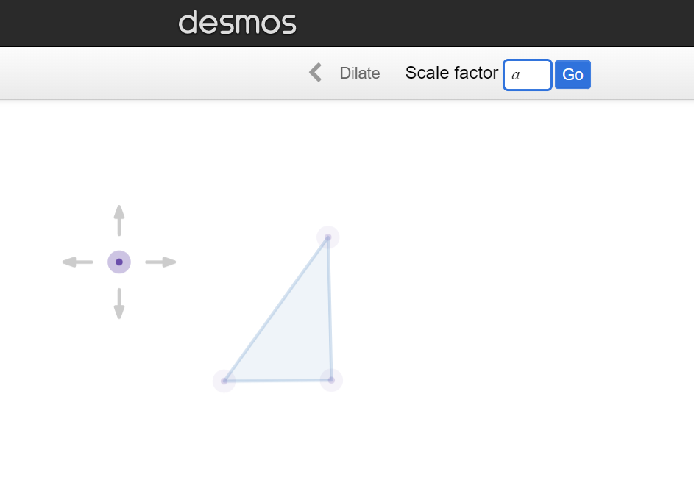
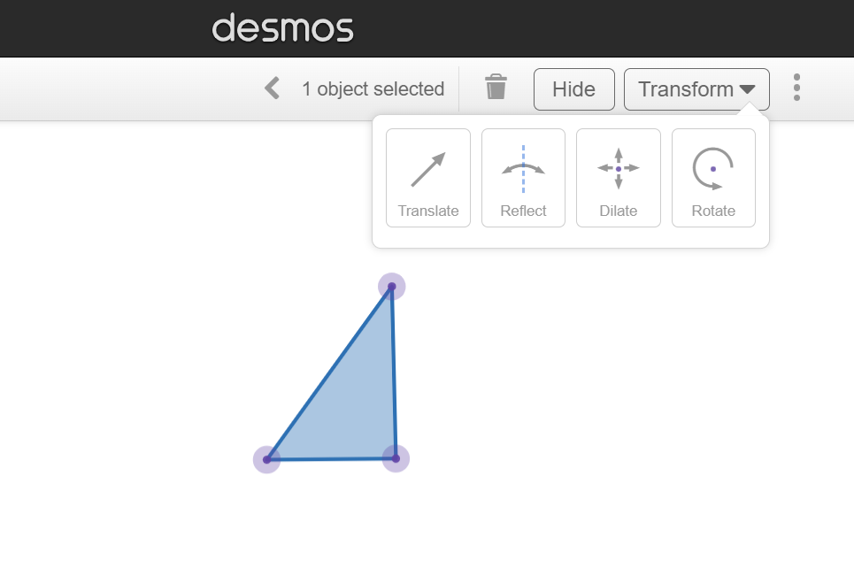
Investigating enlargement with Desmos
We can make the scale factor dynamic by creating a slider.
Carry out the same steps to enlarge an object.
Enter a letter for the scale factor.
A slider appears in the left panel.
Drag the slider left and right to change the scale factor.

Slide 41
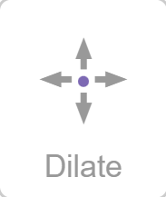
Investigating enlargement with Desmos
What word can be found on this transformation button?
?
dilate
enlarge
move

Slide 42
Investigating enlargement with Desmos
Draw any polygon and enlarge it with a slider scale factor.
1) Drag the slider left and right. a) When is the image larger than the object?
b) When is the image the same size as the object?
c) When is the image smaller than the object?
d) What happens to the image when the scale factor is 0? Why does this
happen? 2) Select the line tool. Click on a vertex on the object and its corresponding vertex on the image to draw a line that traverses both vertices. Repeat for all pairs of corresponding vertices. Where do the lines intersect each other?

Slide 43
Investigating enlargement with Desmos
Draw any polygon and enlarge it with a slider scale factor.
1) Drag the slider left and right. a) When is the image larger than the object?
b) When is the image the same size as the object?
c) When is the image smaller than the object?
d) What happens to the image when the scale factor is 0? Why does this
happen? 2) Select the line tool. Click on a vertex on the object and its corresponding vertex on the image to draw a line that traverses both vertices. Repeat for all pairs of corresponding vertices. Where do the lines intersect each other?
scale factor > 1
scale factor = 1
scale factor < 1
The image disappears because it has no size.
At the centre of enlargement.

Slide 44
Investigating transformations with Desmos
Dynamic geometry software can be used to quickly draw shapes and transform them.
Dynamic software allows us to manipulate aspects of a diagram after a transformation has already taken place.
Sliders can be used to make values such as angles and scale factors dynamic.

Slide 45

© Oak National Academy 2023.
Produced in partnership with Mathematics in Education and Industry.
Licensed on the Open Government Licence v3.0, except where otherwise stated. See Oak terms and conditions.

